Slide 1
JavaScript Web Development
108/06/13

Slide 2

Game
Game for testing your memory

Slide 3
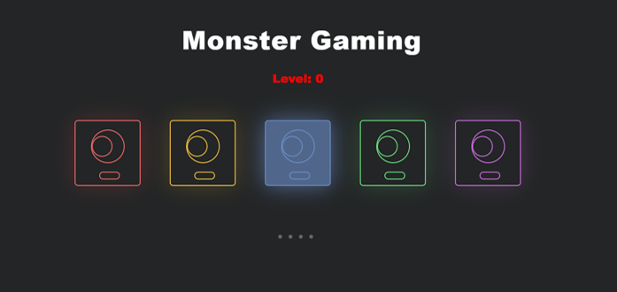
Step 1
Memorize which monster lightens

Slide 4
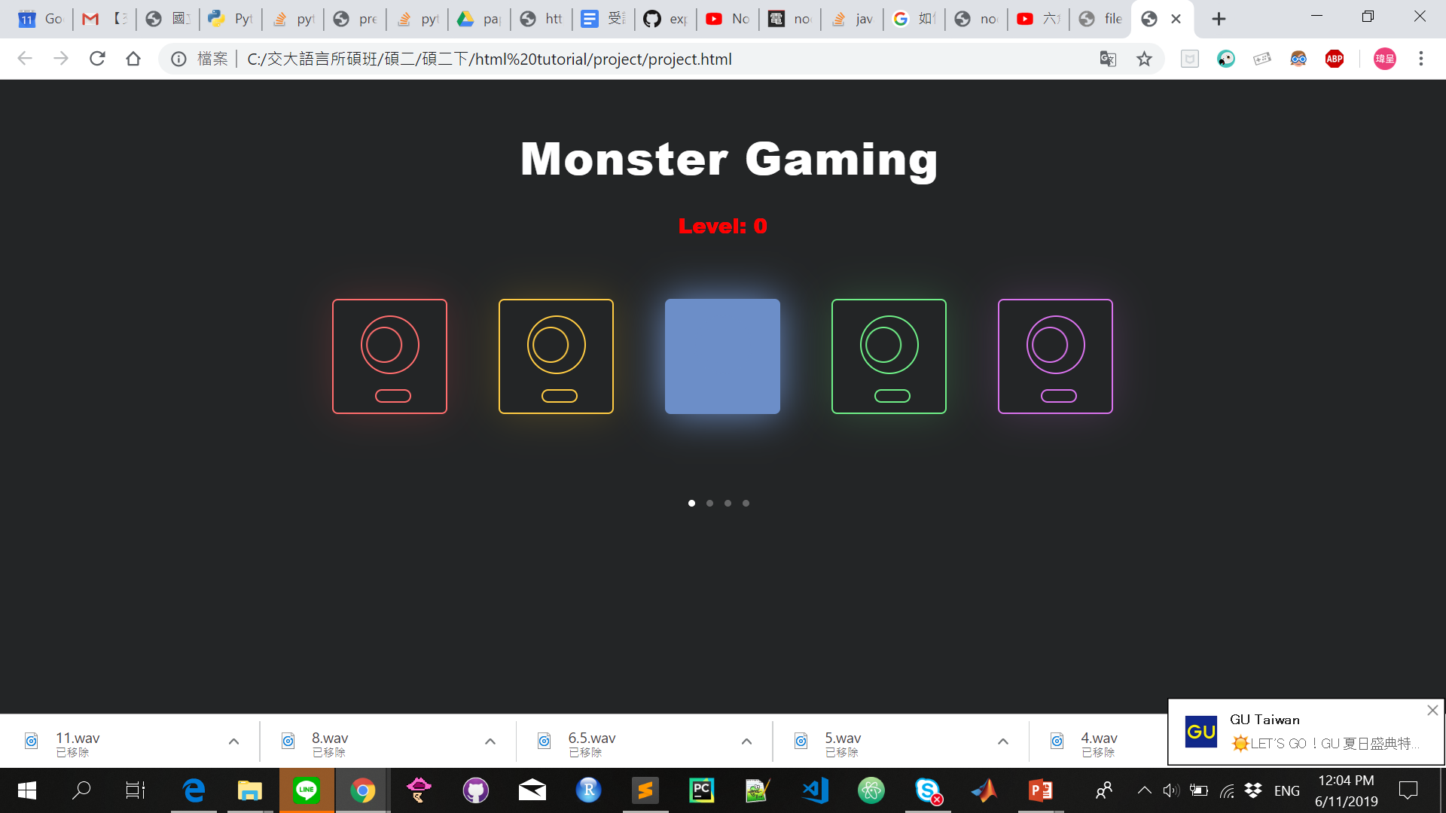
Step 2
Click the monster that lightens within the same order

Slide 5
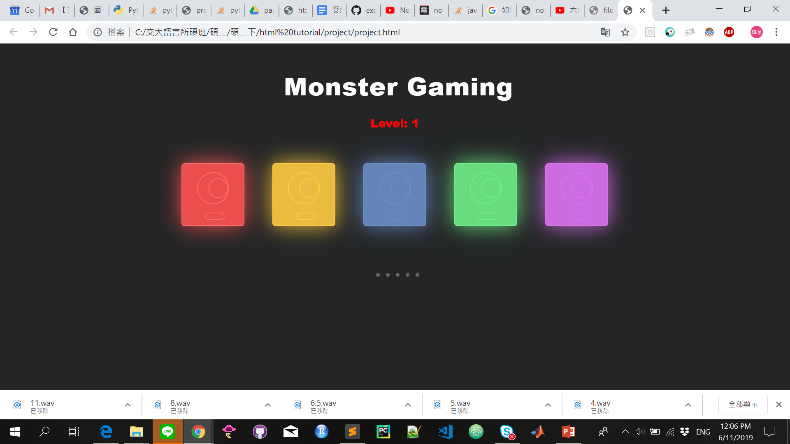
Step 3
Check if you are correct and move on to the next level

Slide 6
Tools involved
01
Editor - Sublime
02
Frontend – html , css, js

Slide 7
Code explanation

Slide 8
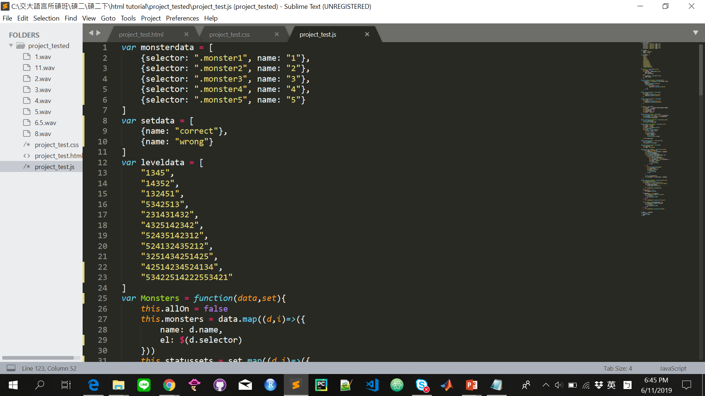
Data involved
Monsterdata (including 2 fields)
Setdata (1 fields)
Leveldata

Slide 9
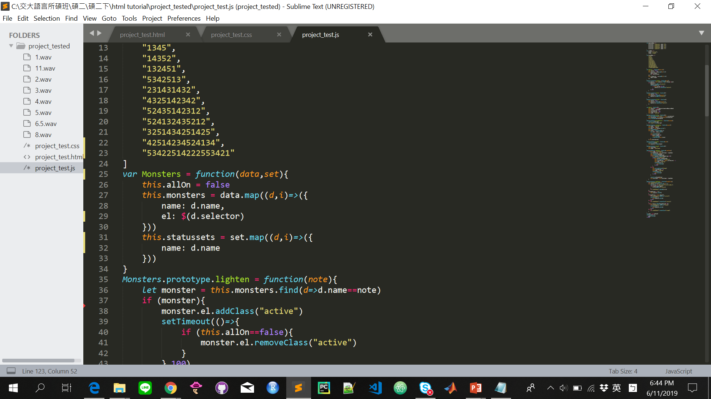
Monster’s object
Monster data
(1) Get the data’s name and selector
2. Set data
(1) Get the data’s name

Slide 10
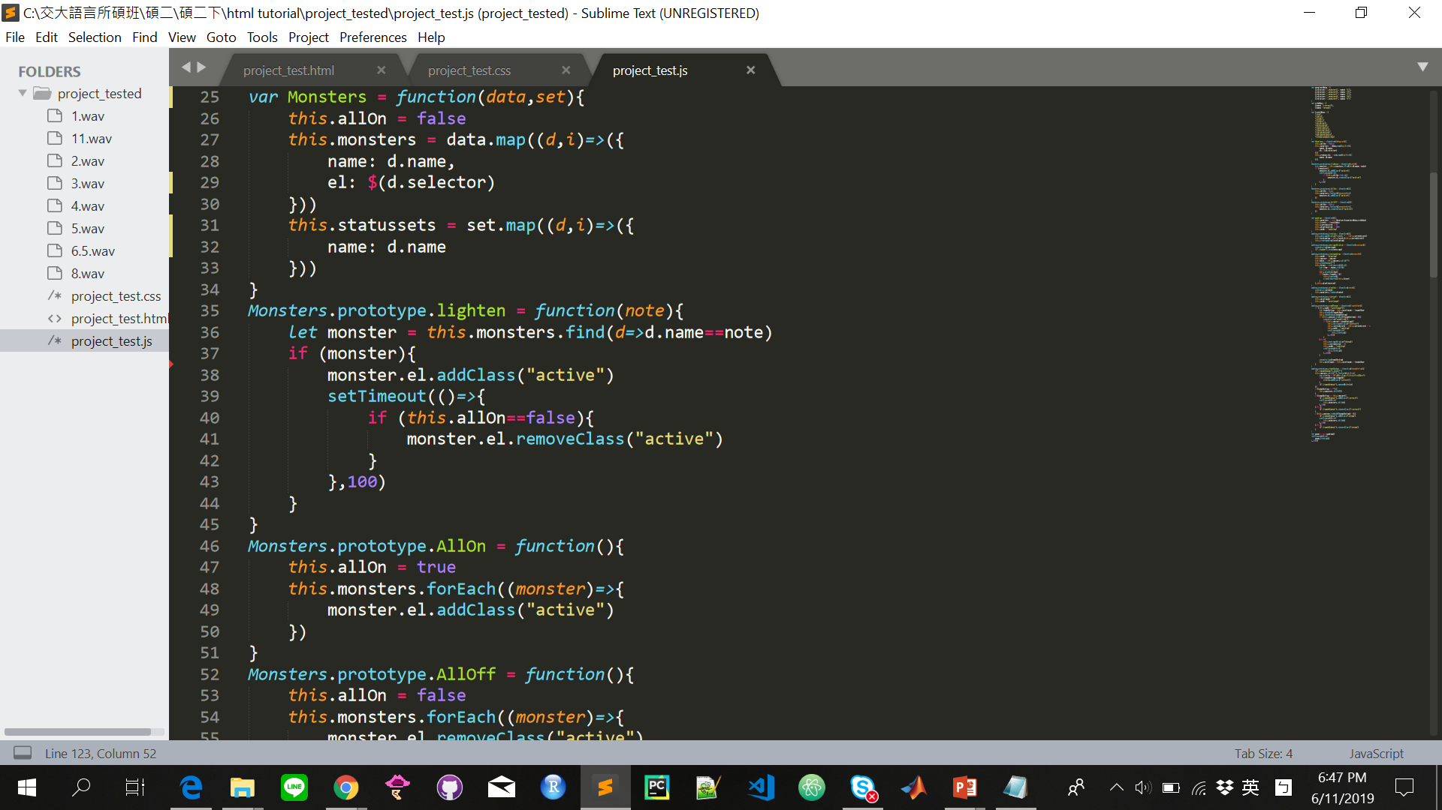
Monster’s object
Match the name passed in with the object name, if it matches…
(1) add class “active”
( make it sprite)
(2) remove class “active” after
100ms
(make sure the sprite is off)

Slide 11
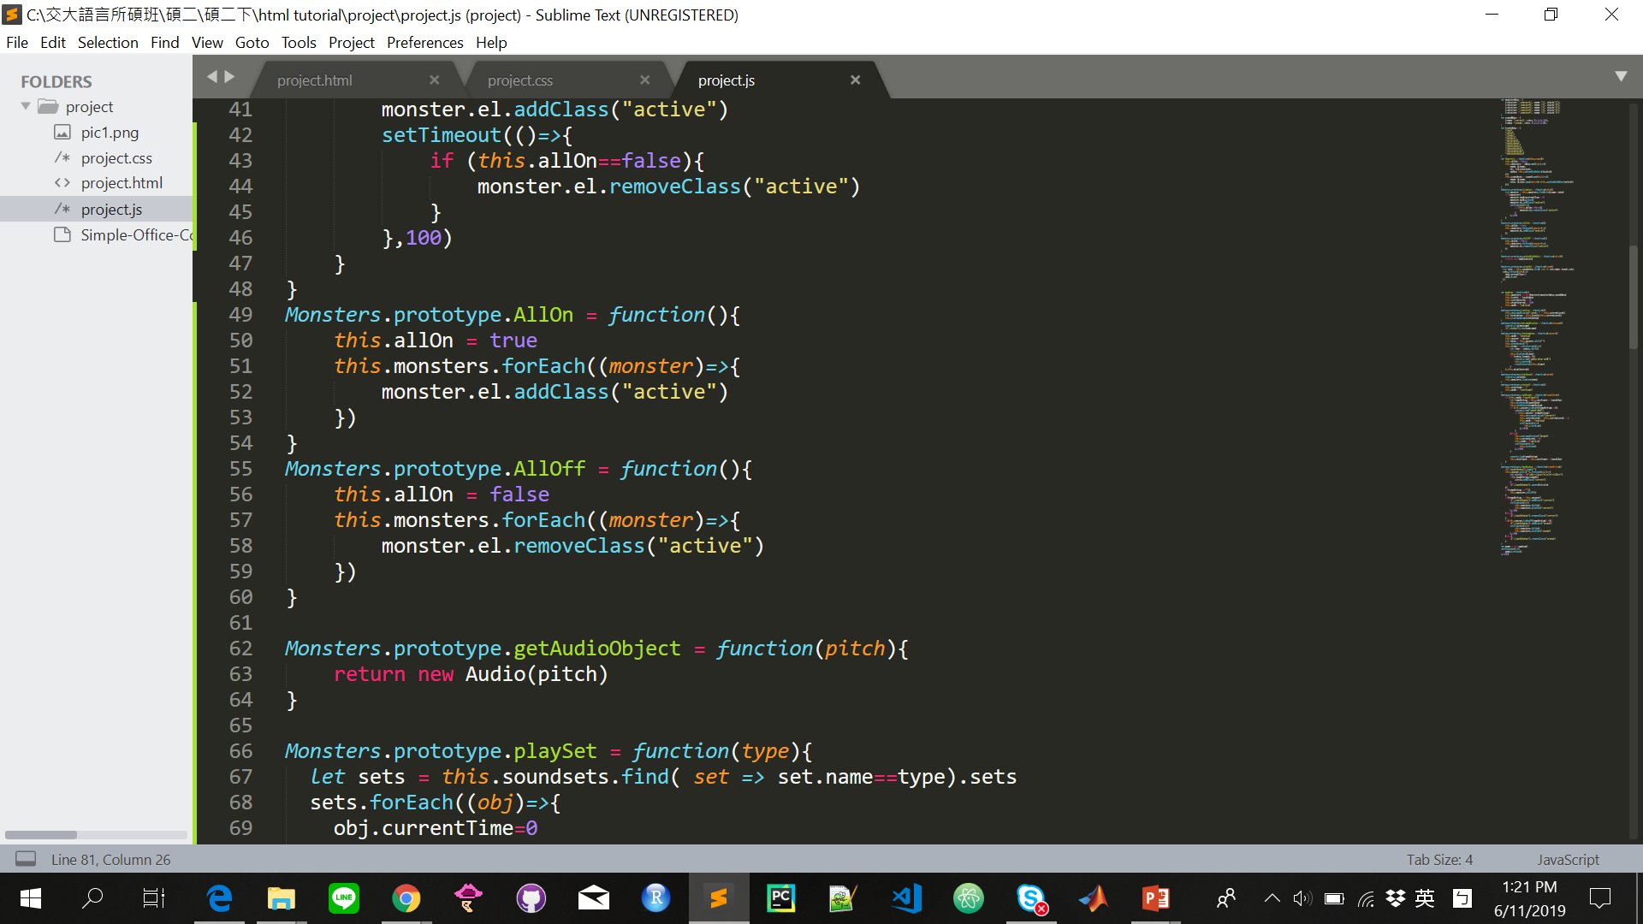
Monster’s object
Create functions that turns all the light
on and off
(when answer is correct and wrong)

Slide 12
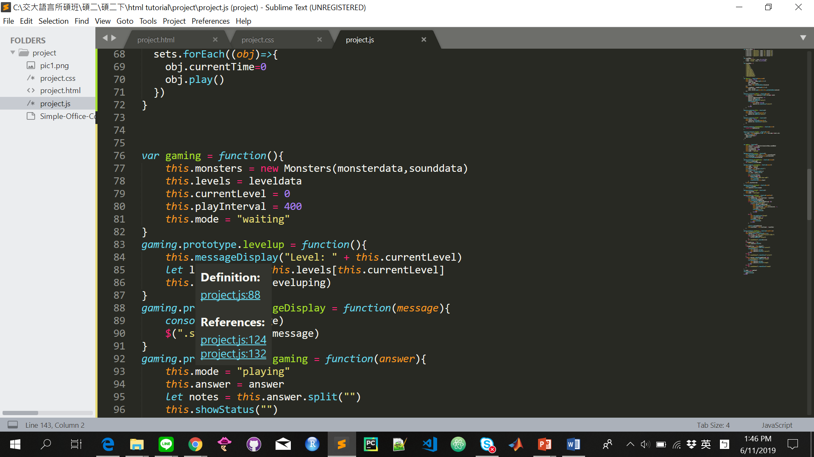
Game object
Create a game object
(1) pass monster’s object in
(2) pass the level data in
(3) set current level to 0
(4) set the play interval = 400
(5) set the mode to waiting

Slide 13
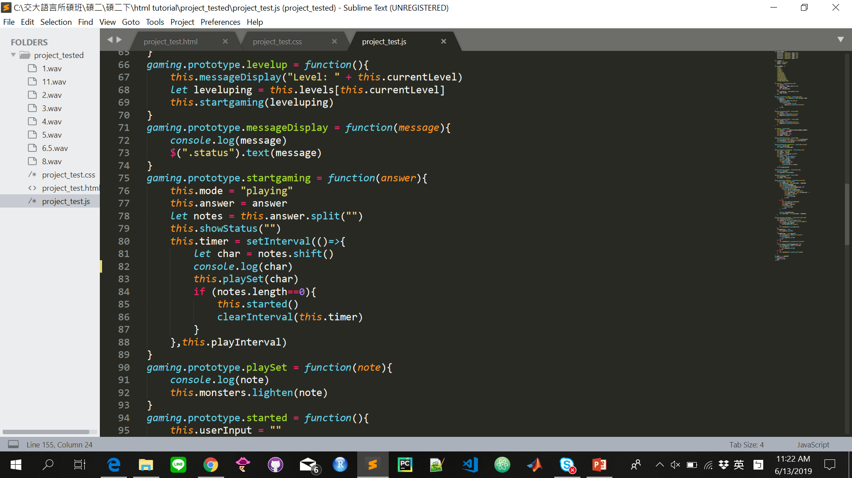
Game object
Set the mode to playing
Play the corresponding answer from the
Level data
(1) split the answer and assign to note
(2) put everything in note to char
(3) if length is 0, then stop

Slide 14
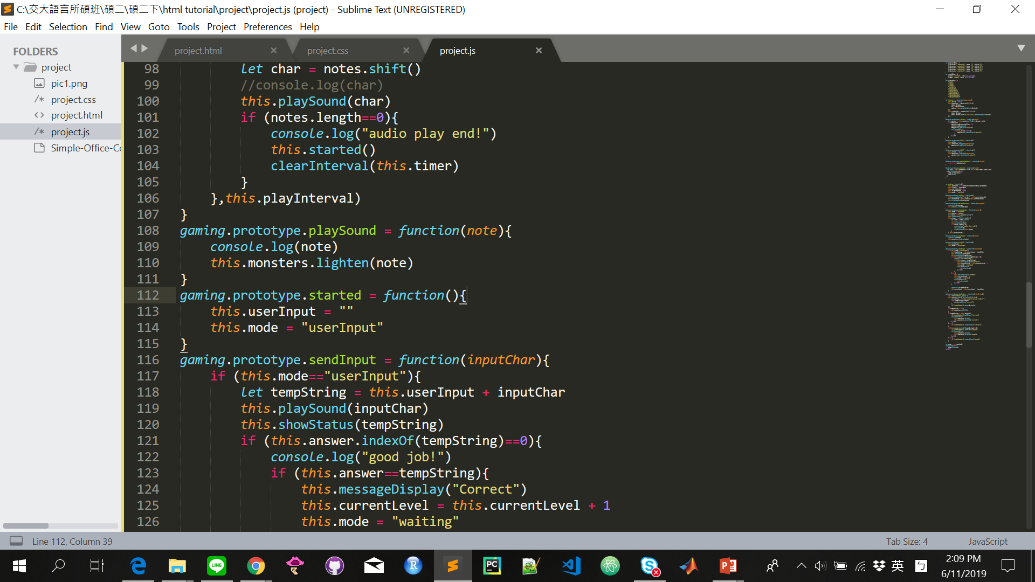
Game object
Create a function to start input
(1) starting a user input
(2) changing the mode to user input

Slide 15
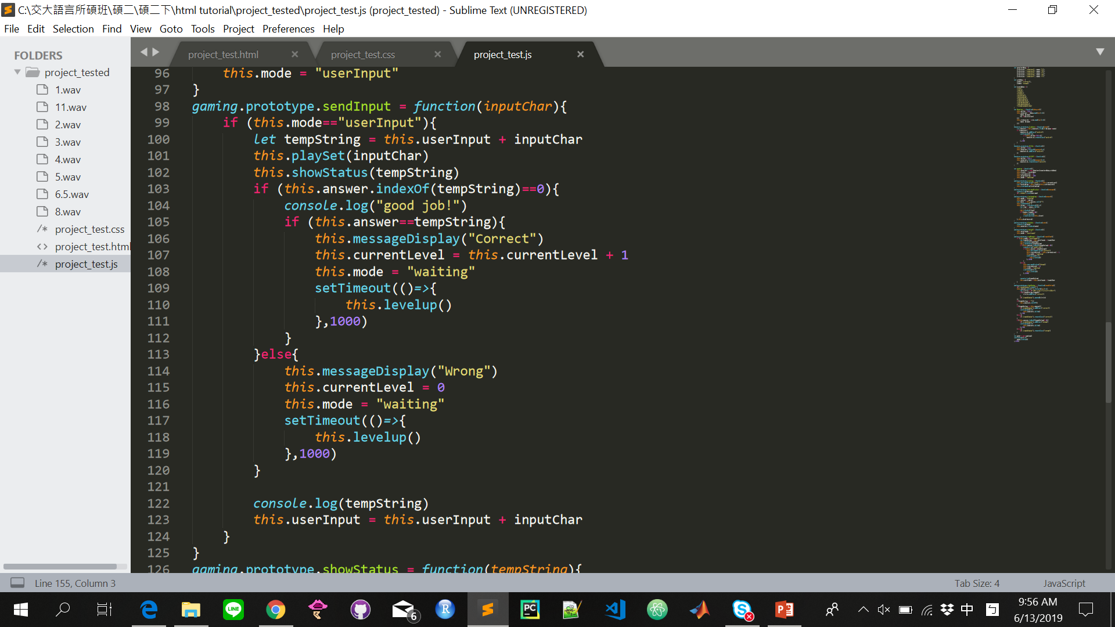
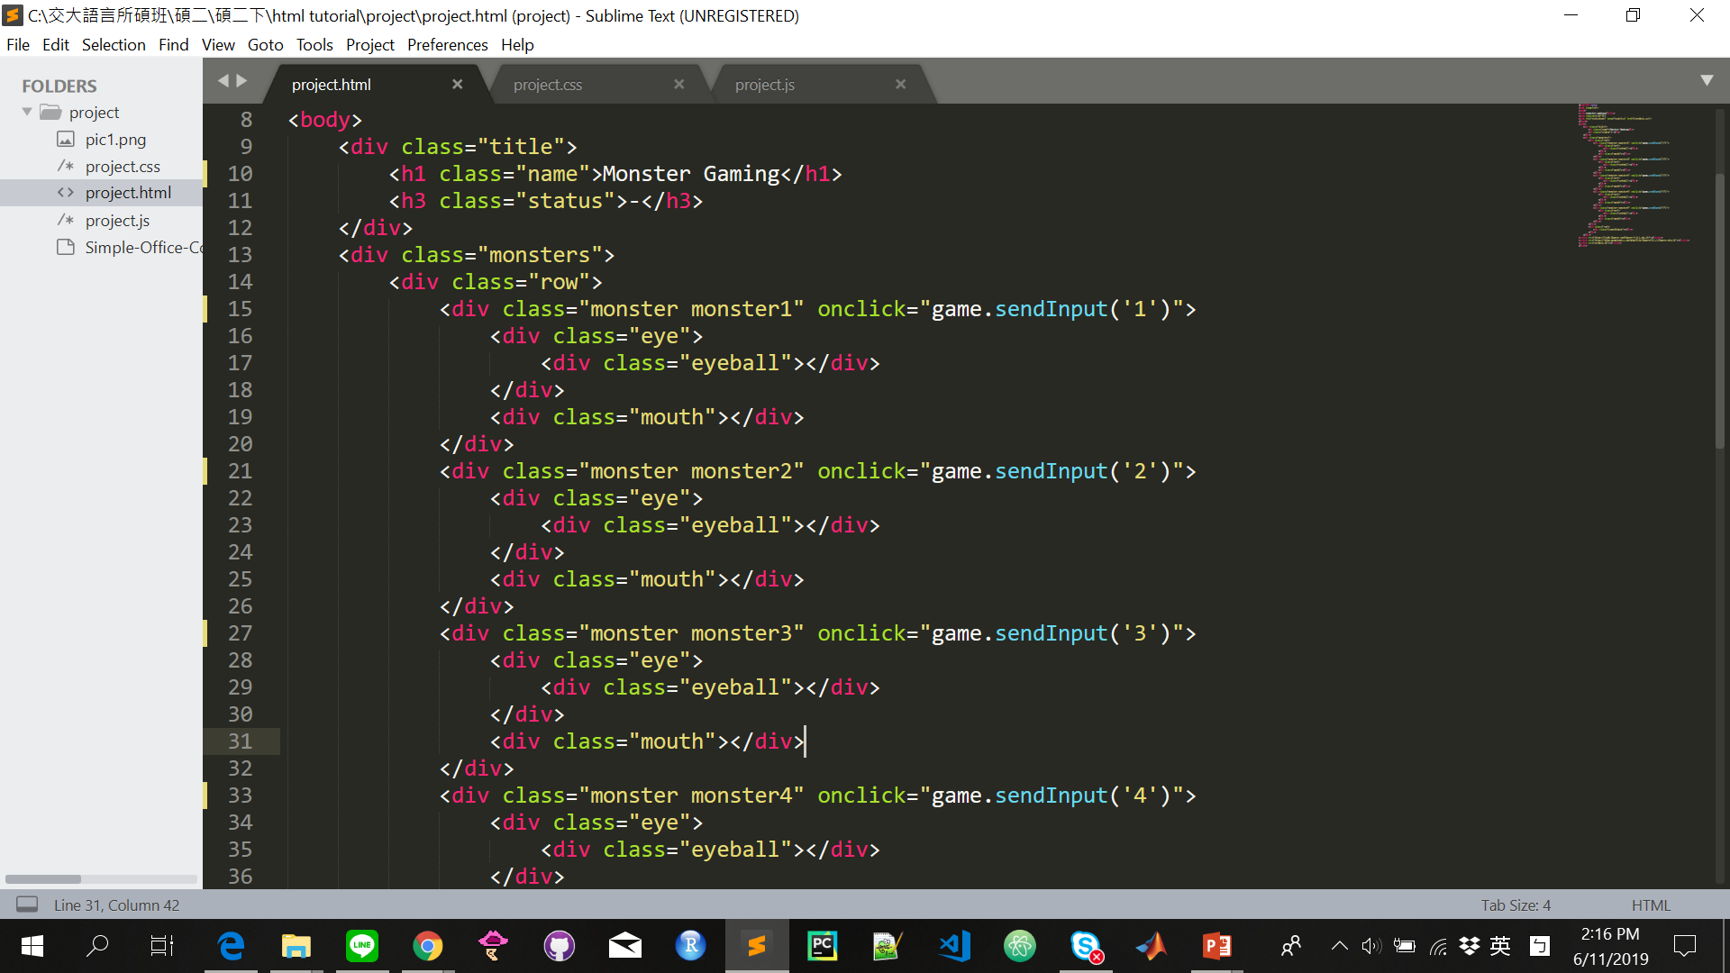
Game object
Create a send input function
(1) switching the mode to user input
(2) put every input to tempstring
(3) check the first position of tempstring
with answer
(4) check the entire tempstring with
answer
(5) if it doesn’t fulfill (3) & (4) it will be
wrong and set everything back

Slide 16
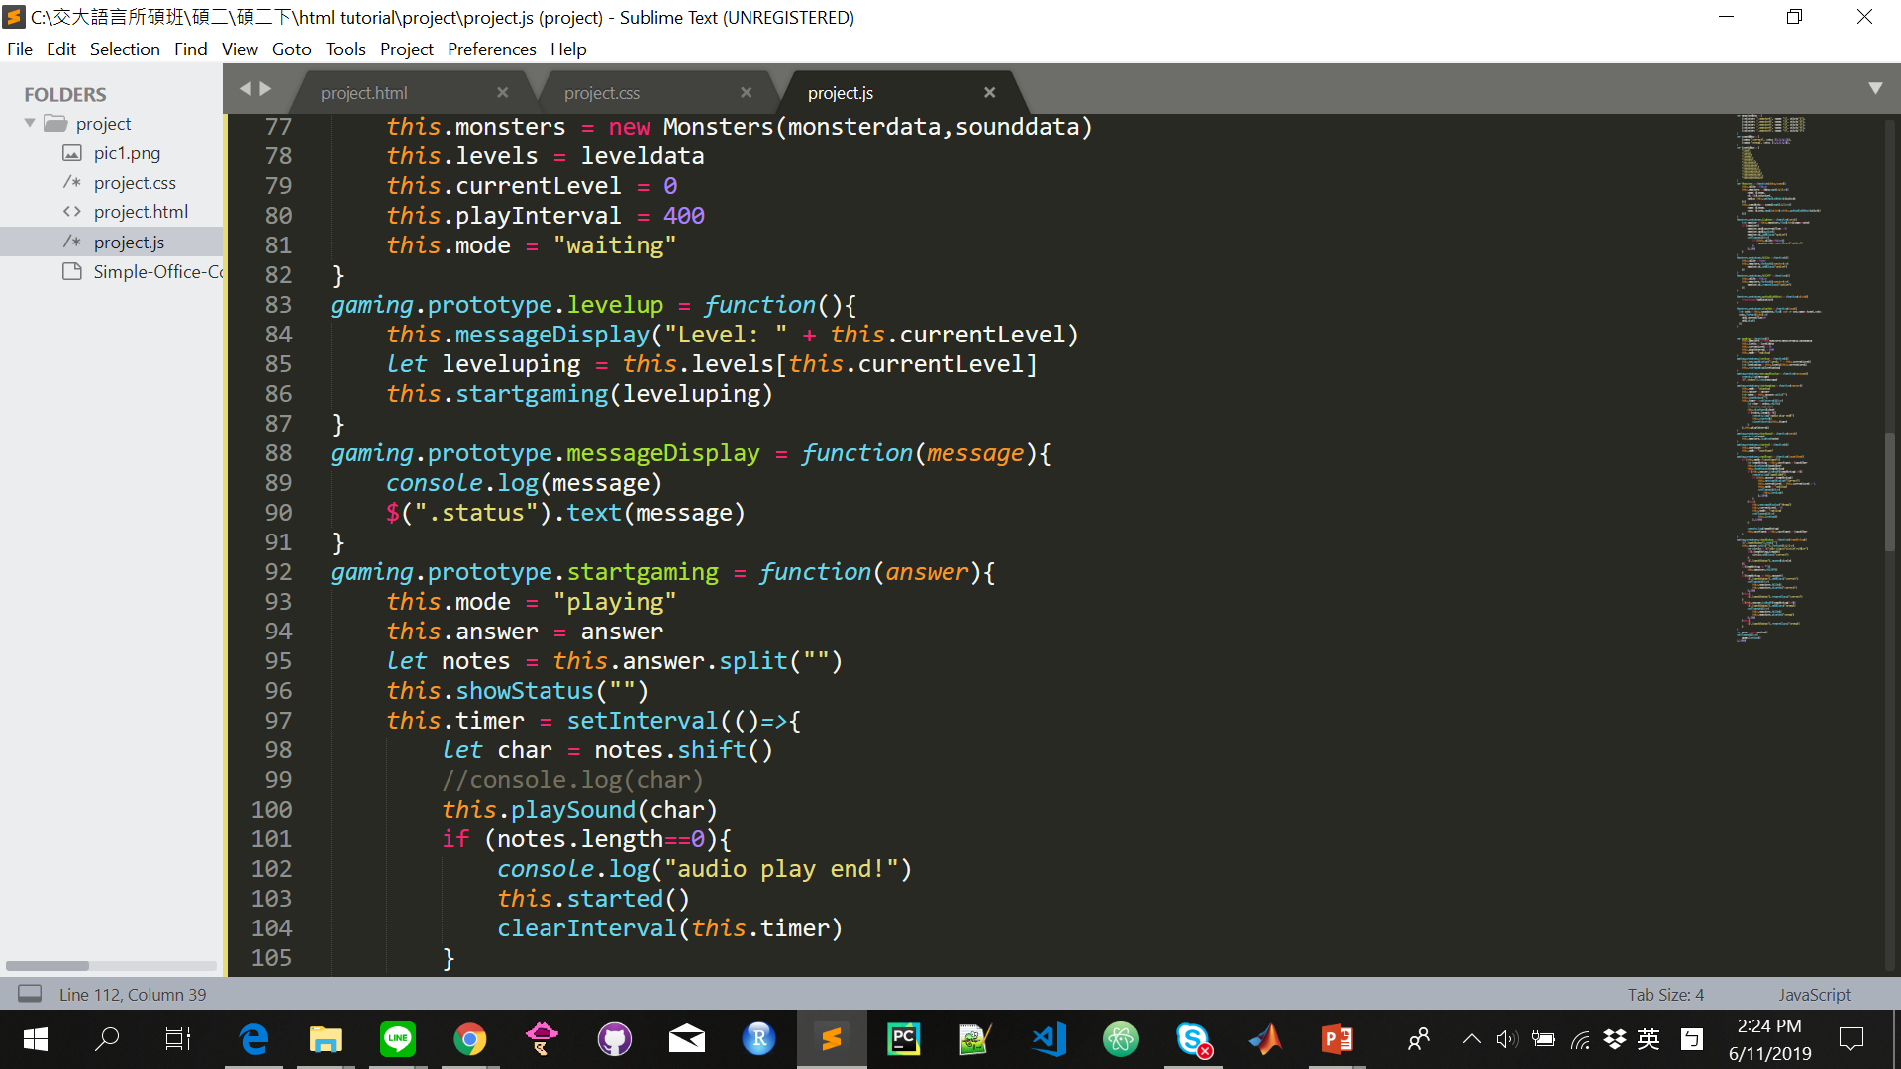
Game object
Changing the status by feeding the message with (“Level: ” + current level)

Slide 17
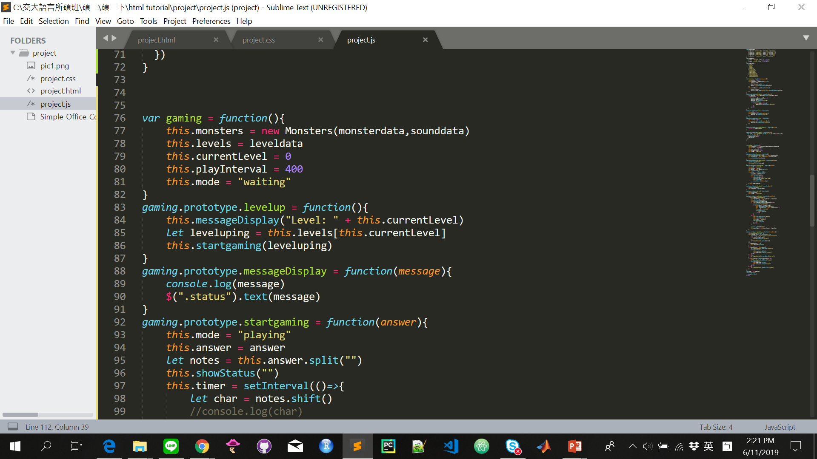
Game object
Send the level data in start gaming
Display the current level

Slide 18
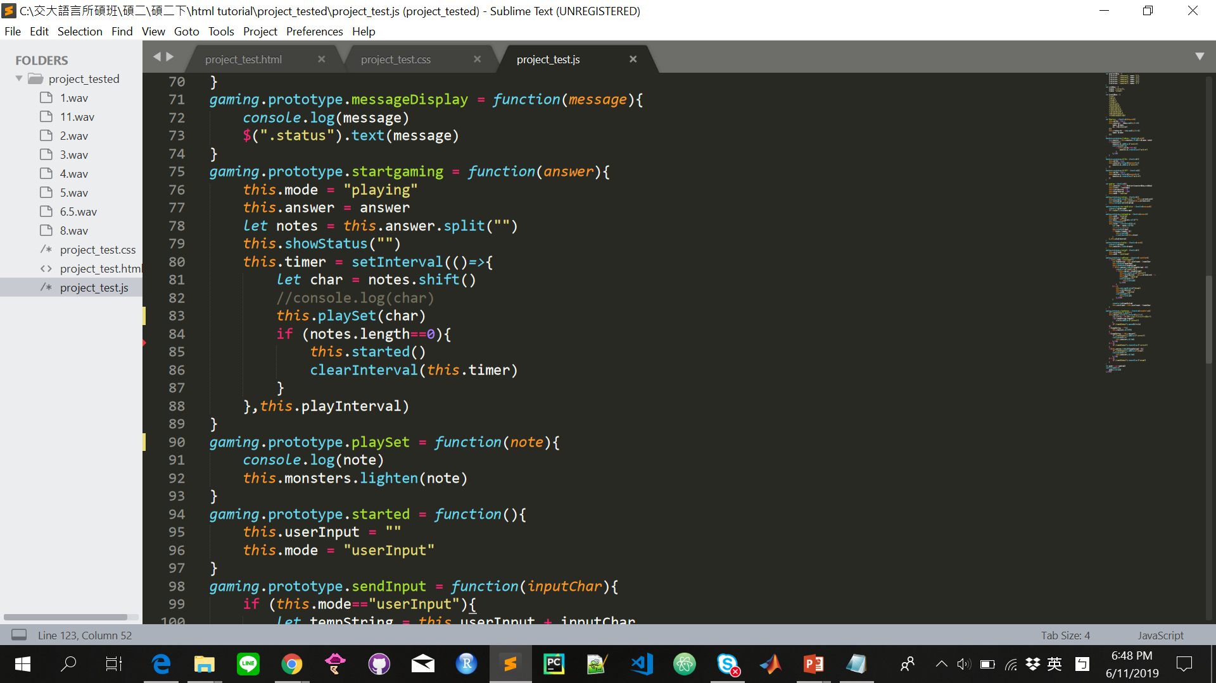
Game object
See if the set is correct or wrong to
trigger the corresponding reponse

Slide 19
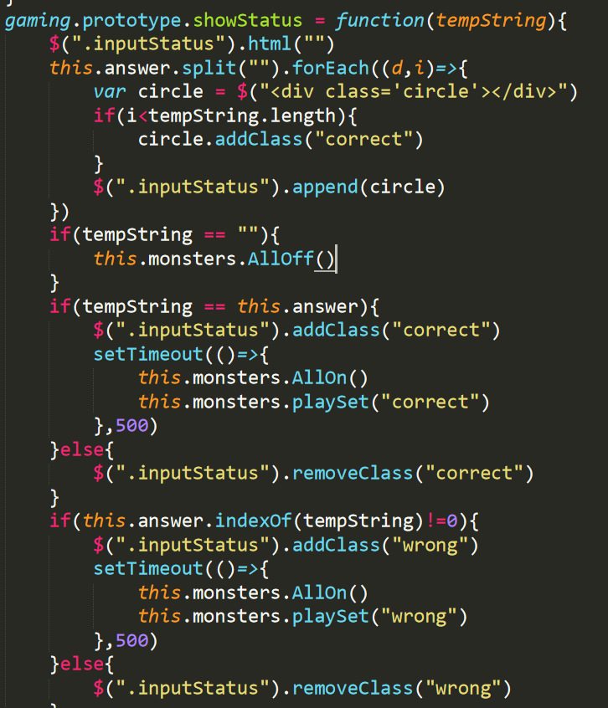
Game object
Add additional circles to correspond to the answer you click
If you have the right answer, the color of circle will turn blue
If you have the wrong answer, the circle will turn red

Slide 20
Code Demo

